Slide 1
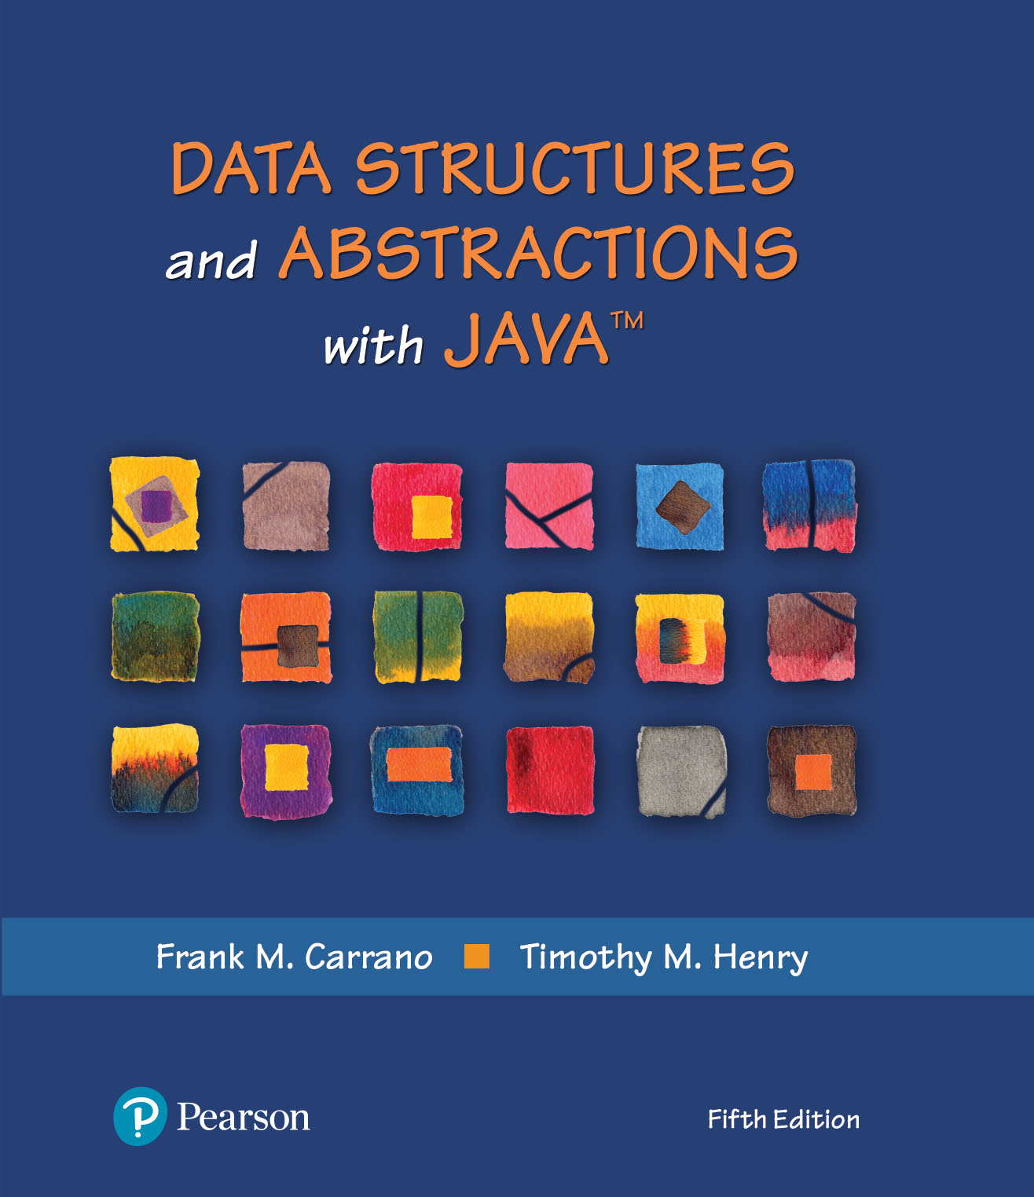
Java Interlude 9 - Cloning

Slide 2
Cloneable Objects
A clone is a copy of an object
Typically, we clone only mutable objects
Sharing an immutable object is safe
Class Object contains a protected method clone that returns a copy of an object
protected Object clone() throws CloneNotSupportedException

Slide 3
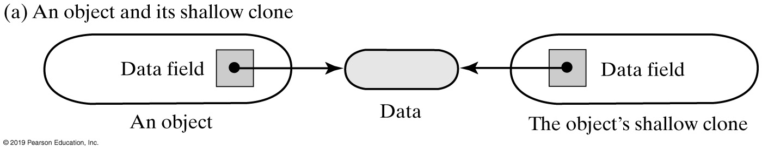
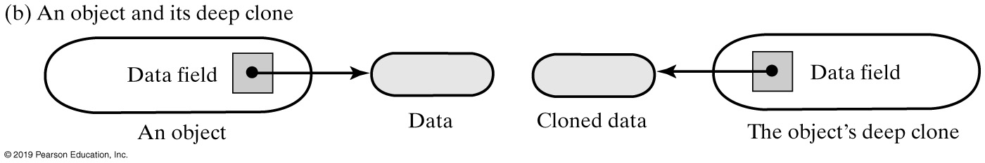
Cloneable Objects
Two clones of an object, shallow and deep

Slide 4
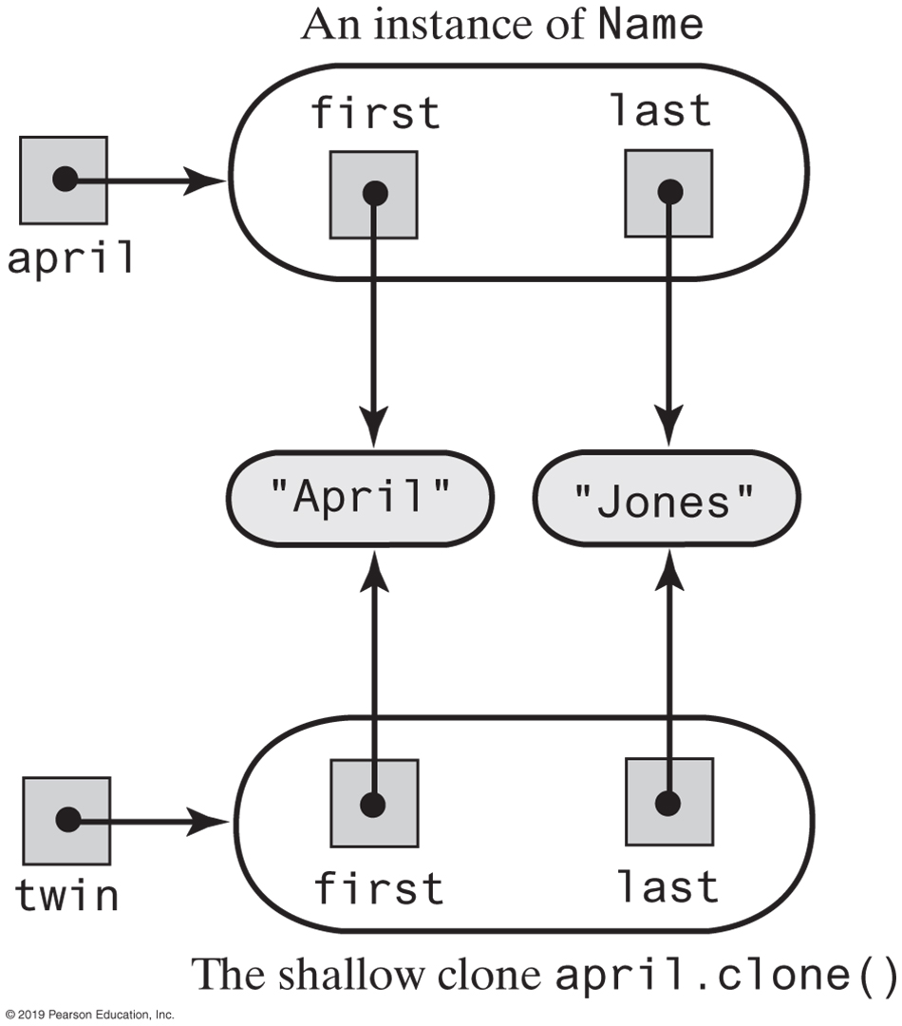
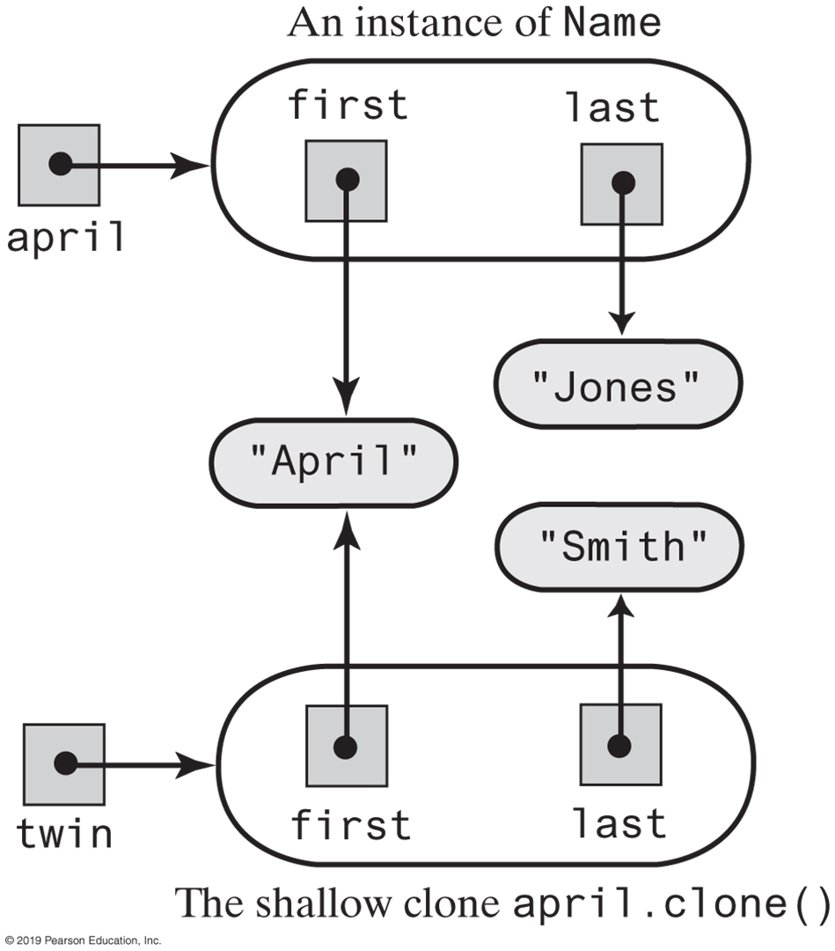
Shallow Clones
An instance of Name and its shallow clone
The clone twin, after the statement twin.setLast(“Smith”) changes one of its data fields

Slide 5
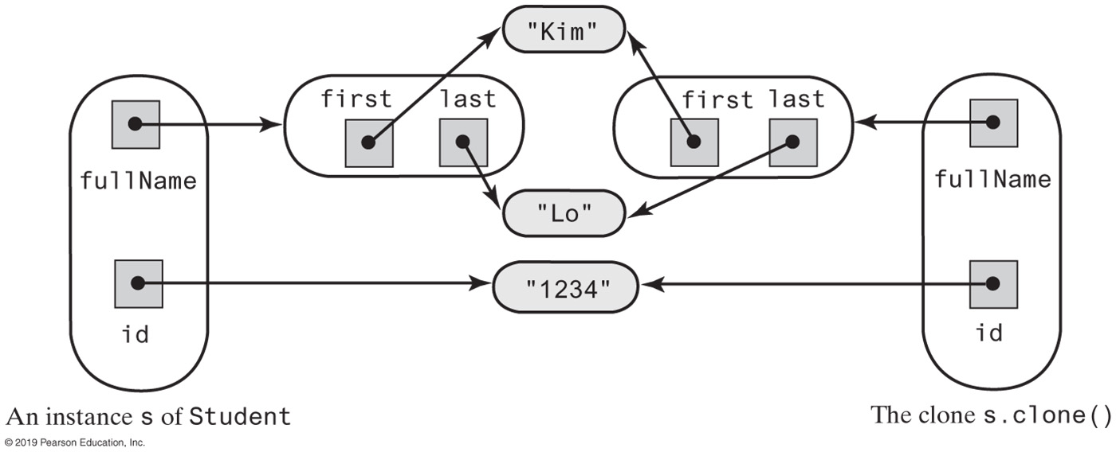
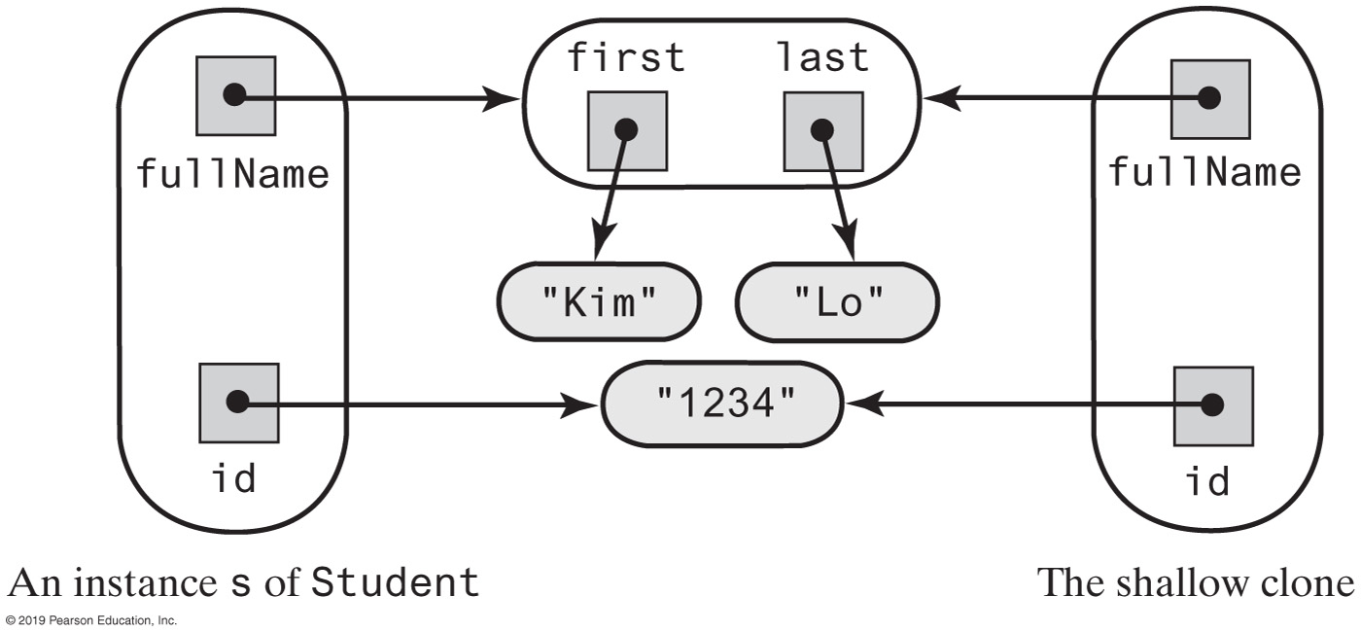
Deep Clones
An instance of Student and its clone, including a deep copy of fullName
An instance of Student and its clone, including a shallow copy of fullName

Slide 6
Clone Examples | Resources
Clone vs. Copy Constructor
https://dzone.com/articles/java-cloning-copy-constructor-vs-cloning
https://howtodoinjava.com/java/cloning/a-guide-to-object-cloning-in-java/
https://www.geeksforgeeks.org/clone-method-in-java-2/

Slide 7
Cloneable Objects
clone is protected, and Object is the superclass of all other classes
Implementation of any method can contain the invocation
Clients of a class cannot invoke clone unless the class overrides it and declares it public
super.clone()

Slide 8
Cloneable Objects
/** A class that represents a student that can be cloned. */
public class Student implements Cloneable
{
private Name fullName;
private String id; // Identification number
/* Constructors and additional method, setters and getters . . . */
public Object clone()
{
Student theCopy = null;
try
{
theCopy = (Student)super.clone(); // Object can throw an exception
}
catch (CloneNotSupportedException e)
{
throw new Error(e.toString());
}
theCopy.fullName = (Name)fullName.clone();
return theCopy;
} // end clone
} // end Student

Slide 9
Cloneable Objects
/** A class that represents a college student. */
public class CollegeStudent extends Student implements Cloneable
{
private int year; // Year of graduation
private String degree; // Degree sought
/* Constructors and the methods setStudent, setYear, getYear,
setDegree, getDegree, toString, and clone go here.
. . . */
public Object clone()
{
CollegeStudent theCopy = (CollegeStudent)super.clone();
return theCopy;
} // end clone
} // end CollegeStudent
Add a clone method to a subclass of Student

Slide 10
Cloning an Array
/** An interface for a public clone method. */
public interface Copyable extends Cloneable
{
public Object clone();
} // end Copyable
Define a new interface that declares a public method clone to override Object’s protected method
public class AList<T extends Copyable> implements ListInterface<T>, Cloneable
public class AList<T extends Copyable> implements ListInterface<T>, Copyable
public class AList<T extends Copyable> implements CloneableListInterface<T>
Then begin Alist one of different possible ways

Slide 11
Cloning an Array (Shallow Copy)
public Object clone()
{
AList<T> theCopy = null;
try
{
@SuppressWarnings("unchecked")
AList<T> temp = (AList<T>)super.clone();
theCopy = temp;
}
catch (CloneNotSupportedException e)
{
throw new Error(e.toString());
}
/* For a deep copy, we need to do more here, as you will see
. . . */
return theCopy;
} // end clone
https://www.baeldung.com/java-array-copy

Slide 12
Cloning an Array (Deep Copy)
public Object clone() {
AList<T> theCopy = null;
// Clone the list
try
{
@SuppressWarnings("unchecked")
AList<T> temp = (AList<T>)super.clone();
theCopy = temp;
}
catch (CloneNotSupportedException e)
{
throw new Error(e.toString());
}
// Clone the list's array
theCopy.list = list.clone();
// Clone the entries in the array (list[0] is unused and ignored)
for (int index = 1; index <= numberOfEntries; index++)
{
@SuppressWarnings("unchecked")
T temp = (T)list[index].clone();
theCopy.list[index] = temp;
} // end for
return theCopy;
} // end clone

Slide 13
Cloning a Chain
public class LList<T extends Copyable> implements CloneableListInterface<T>
{
private Node firstNode; // Reference to first node of chain
private int numberOfEntries;
// . . .
Need a clone method to a linked implementation of the ADT list, such as class LList

Slide 14
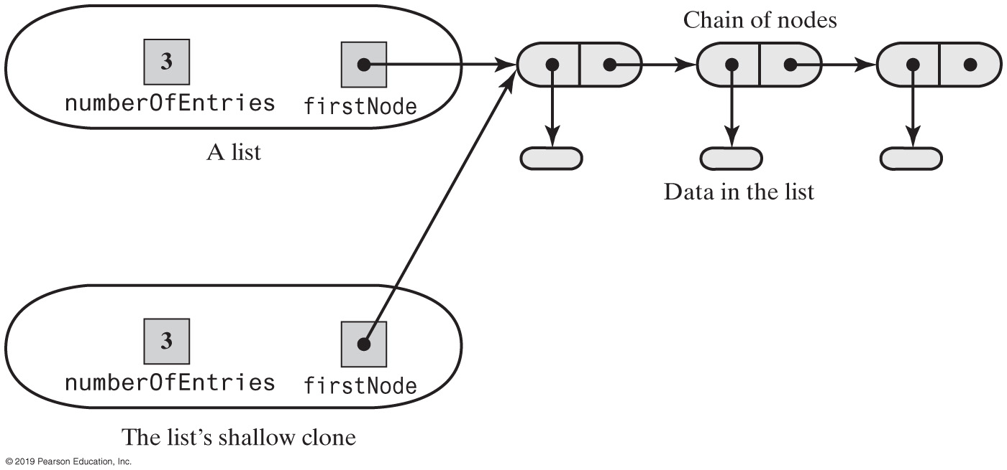
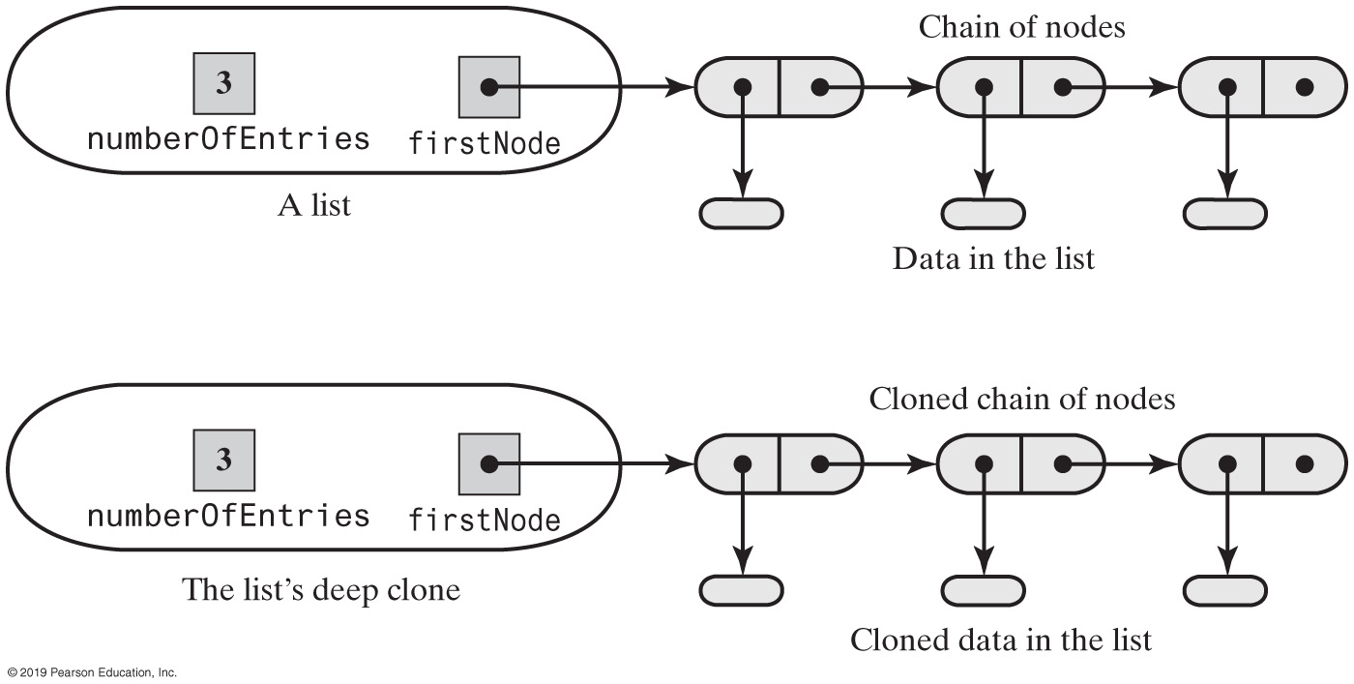
Cloning a Chain
A list and its shallow clone: linked implementation
A list and its deep clone: linked implementation

